Slide 1
Chapter 14: String functions
2023

Slide 2
Chapter 14: String functions
Contents:
Different concatenation functions
Left/right functions
String manipulation functions
Coalesce
Null functions

Slide 3
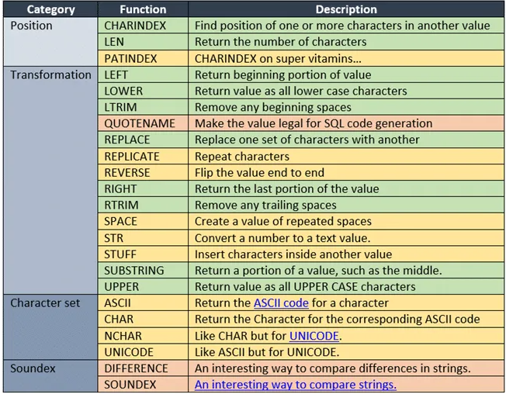
MS Access String / Text Functions
These are some string functions and their purpose:
Notes:
https://www.w3schools.com/
sql/sql_ref_msaccess.asp
https://dev.mysql.com/doc/refman/8.0/en/string-functions.html
Most people don t use many of these
Can also combine concat and substring → concat(substring(title 1 10) ... ) --→
MySQL - SELECT CONCAT( MS SQL Tips ) MsSQL - SELECT ( MS + SQL + Tips )
Date functions → https://dev.mysql.com/doc/refman/8.0/en/date-and-time-functions.html

Slide 4
Concat function
To join two or more strings into one you use the CONCAT() function
The syntax: CONCAT ( input_string1, input_string2…)
The CONCAT() function also converts NULL into an empty string with the type VARCHAR(1).
Notes:
Advanced
Some databases support concat, some needs non-string types to be converted etc

Slide 5
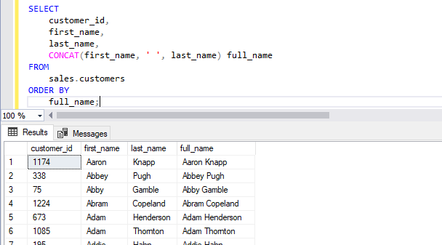
Concat function example

Slide 6
Concat vs concat_WS
The main difference between the two functions is how they handle the separator between the concatenated strings.
CONCAT() function takes two or more expressions as arguments and concatenates them together, without adding any separator between them.
CONCAT(string1, string2, ...., string_n)
SELECT CONCAT('Hello', 'World'); -- Output: HelloWorld
On the other hand, CONCAT_WS() function also concatenates two or more strings, but it allows you to specify a separator between the strings. The first argument of the function is the separator, and subsequent arguments are the strings to concatenate.
CONCAT_WS(separator, string1, string2, ...., string_n)
SELECT CONCAT_WS(',', 'John', 'Doe', '42'); -- Output: John,Doe,42

Slide 7
CONCAT_WS()
The SQL Server CONCAT_WS() function concatenates two or more strings into one string with a separator.
The syntax: CONCAT_WS(separator, input_string1, input_string2...);
1. The separator is a character-based expression that will be used to separate characters.
2. The input_string1 to input_stringN are expressions of any type. The CONCAT_WS() function implicitly converts values of non-character type to character type before concatenation.
Notes:
Note that the CONCAT_WS() requires at least two input strings. It means that if pass zero or one input string argument the function will raise an error.
The CONCAT_WS() function treats NULL as an empty string of type VARCHAR(1). It also does not add the separator between NULLs. Therefore the CONCAT_WS() function can cleanly join strings that may have blank values.

Slide 8
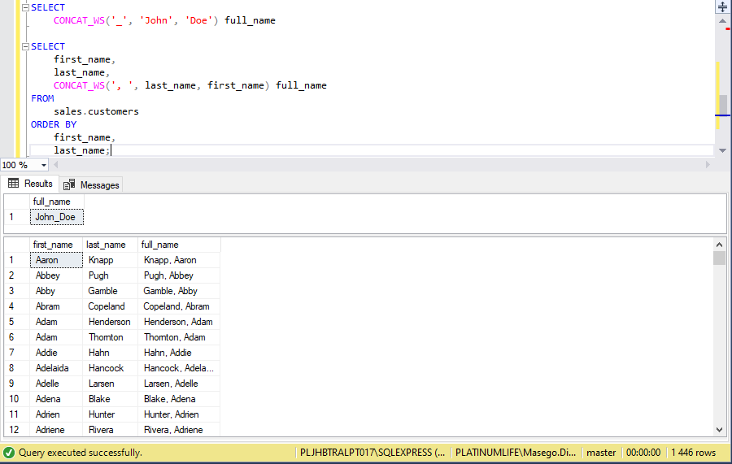
CONCAT_WS() example

Slide 9
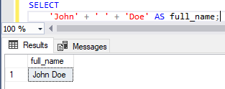
An alternative option to Concatenate
Notes:
An alternative

Slide 10
CHARINDEX()
SQL Server CHARINDEX() function searches for a substring inside a string, starting from a specified location.
It returns the position of the substring found in the searched string or zero if the substring is not found. The starting position returned is 1-based not 0-based.
Notes:
Find a character in a piece of text:
Where is the “and” positioned in the text

Slide 11
CHARINDEX()
The syntax: CHARINDEX(substring, string, [start_location])
1.The substring is the substring to search for. Its length is limited to 8 000 characters.
2. The string can be a literal string, expression or column. It is a string to search.
3. The start_location is the location at which the search starts.
4. The start_location parameter is optional. If it is skipped zero or negative value, the search starts at the beginning of the string.
Note that the CHARINDEX() function can perform both case-sensitive and case-insensitive searches based on the specified collation.
Notes:
MySQL - Position

Slide 12
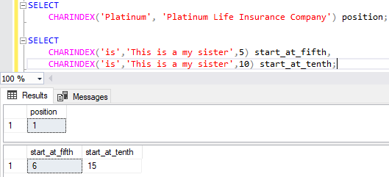
CHARINDEX() example

Slide 13
STRING_AGG()
The STRING_AGG() is an aggregate function that concatenate the values of a column into a single string, separated by a specified separator. It does not add the separator at the end of the result string.
The syntax: STRING_AGG ( input_string, separator )
Select Tutor, STRING_AGG(Studentname, “,”) Students
From Training
Group by Tutor
Tutor | Students
Ilze | Jack, Judith, Mary
Fortune | Lisa, George, Peter
Jayna | Elie, Lee, Tanya, Rose
Notes:
Order clause can include group by or within group

Slide 14
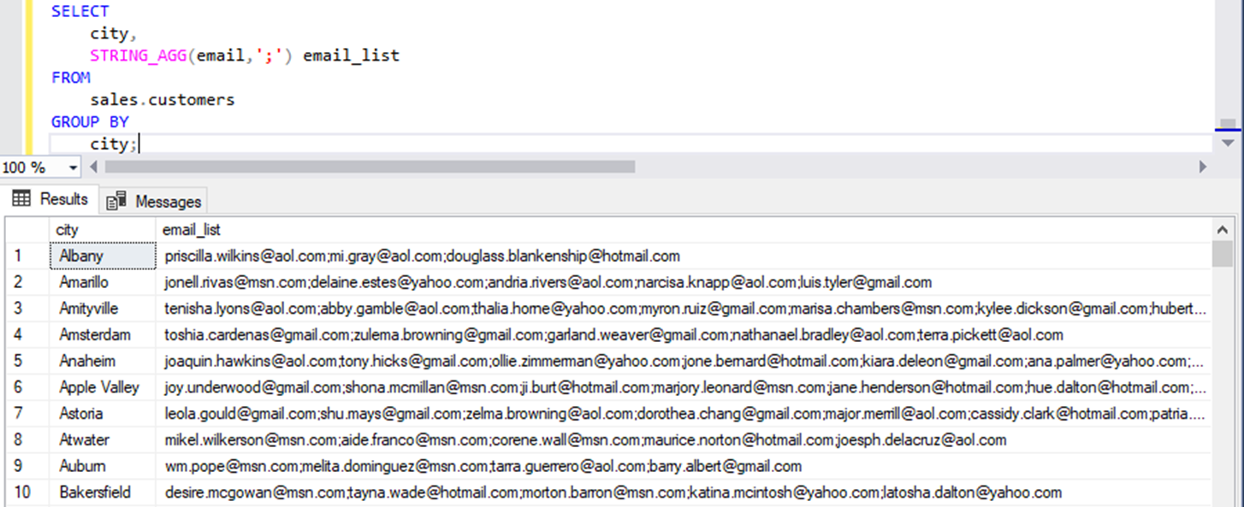

Slide 15
LEFT()
The LEFT() function extracts a given number of characters from the left side of a supplied string. For example: LEFT( SQL Server, 3) returns SQL.
The syntax: LEFT(input_string, number_of_characters )
The number_of_characters is a positive integer that specifies the number of characters of the input_string will be returned.
Exercise:
Use the LEFT() function to return a set of initials of the product name (first letter/character of the product name) and count the number of each product for each initial. #Hint you may use the group by clause.
Notes:
Answer-
SELECT
LEFT(product_name , 1) initial
COUNT(product_name) product_count
FROM
production.products
GROUP BY
left(product_name 1)
ORDER BY
initial;

Slide 16
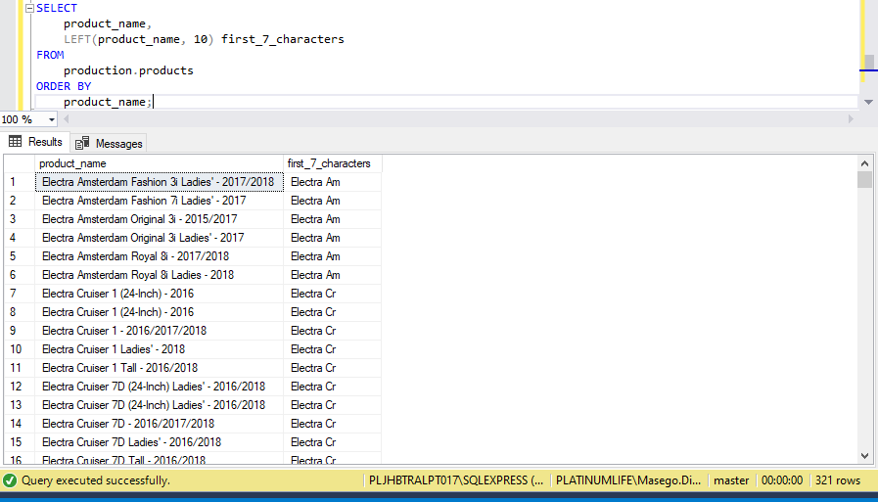
Left() example

Slide 17
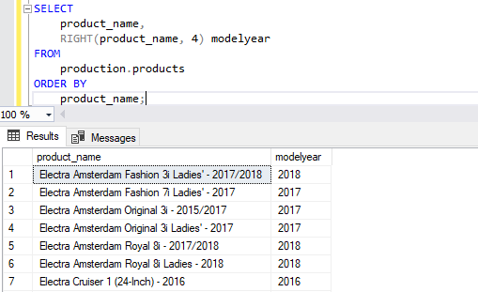
RIGHT()
The RIGHT() function extracts a given number of characters from the right side of a specified character string.
The syntax:RIGHT ( input_string number_of_characters )

Slide 18
SUBSTRING()
The SUBSTRING() extracts a substring with a specified length starting from a location in an input string.
The syntax: SUBSTRING(string, start, length)
1.The column_name is the field to extract characters from
2. Start is the specific the starting position (starts at 1)
3. The length is the number of characters to return and it s usually optional. If omitted, the SUBSTRING() function returns the rest of the text
Notes:
Extract domain from email, for example: google.com, yahoo.com etc.
See next slide

Slide 19
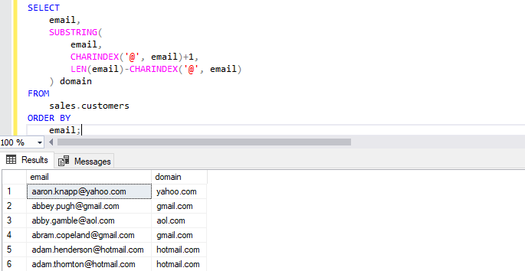
SUBSTRING() example
Notes:
Example explained: First we used the CHARINDEX() function to search for the @ character in the email. The domain will start from the @ character plus one.
Then we used the result of the CHARINDEX() function to determine:
The starting location of the domain: CHARINDEX( @ email) + 1
The length of the domain: LEN(email)-CHARINDEX( @ email)

Slide 20
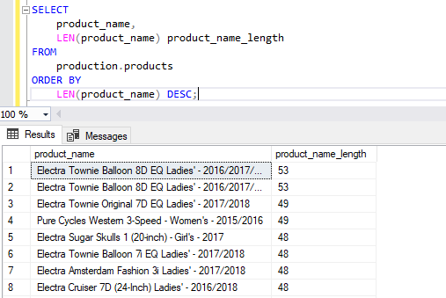
LEN()
The LEN() function returns the number of characters of an input string excluding the trailing blanks.
The syntax: LEN(input_string)
Notes:
MySQL – char_length or length

Slide 21
LOWER() & UPPER()
The LOWER() function converts a string into lowercase.
The syntax: LOWER(input_string)
The UPPER() function converts an input string into uppercase.
The syntax: UPPER(input_string)

Slide 22
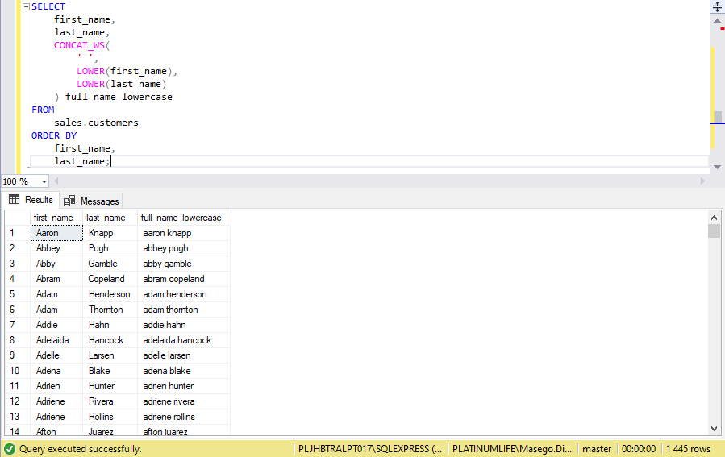
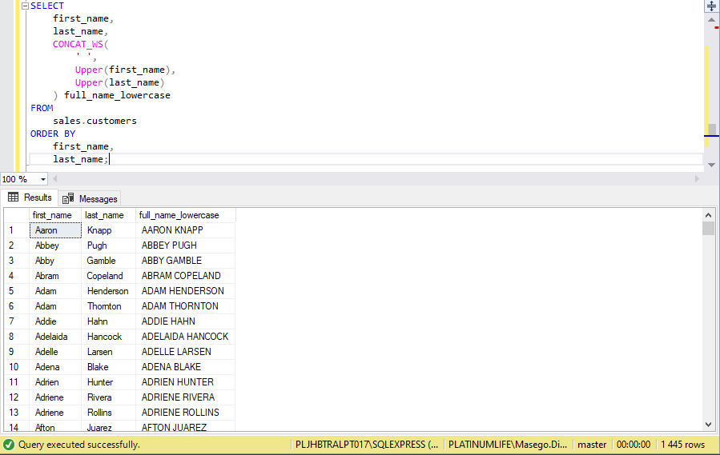
LOWER() & UPPER() Example
Lower()
Upper()

Slide 23
LTRIM() & RTRIM() & Trim()
The LTRIM() function returns a string after removing leading blanks.
The syntax: LTRIM(input_string)
The RTRIM() function returns a string after truncating all trailing blanks.
the syntax: RTRIM(input_string)
The TRIM() function removes spaces or specified characters from both ends of a string.
The syntax: TRIM([removed_characters FROM] input_string)

Slide 24
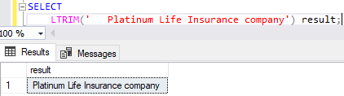
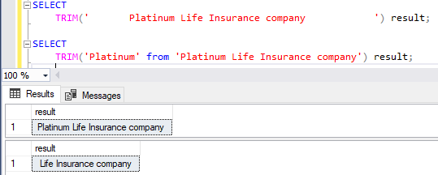
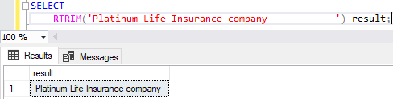
LTRIM() & RTRIM() & Trim() examples

Slide 25
Trim
SELECT TRIM(' Hello ') AS Result; -- Output: 'Hello'
SELECT TRIM(LEADING '0' FROM '0000123') AS Result; -- Output: '123'
SELECT TRIM(TRAILING '!' FROM 'Hello!!!') AS Result; -- Output: 'Hello'
Notes:
You can also use TRIM() to remove other specified characters from a string, and specify the position (leading or trailing) of the characters to remove.

Slide 26
REPLACE()
REPLACE() function to replace all occurrences of a substring by a new substring within a string.
The syntax: REPLACE(input_string, substring, new_substring);
1. The input_string is any string expression to be searched.
2. The substring is the substring to be replaced.
3. The new_substring is the replacement string.
The REPLACE() function returns a new string in which all occurrences of the substring
are replaced by the new_substring. It returns NULL if any argument is NULL.

Slide 27
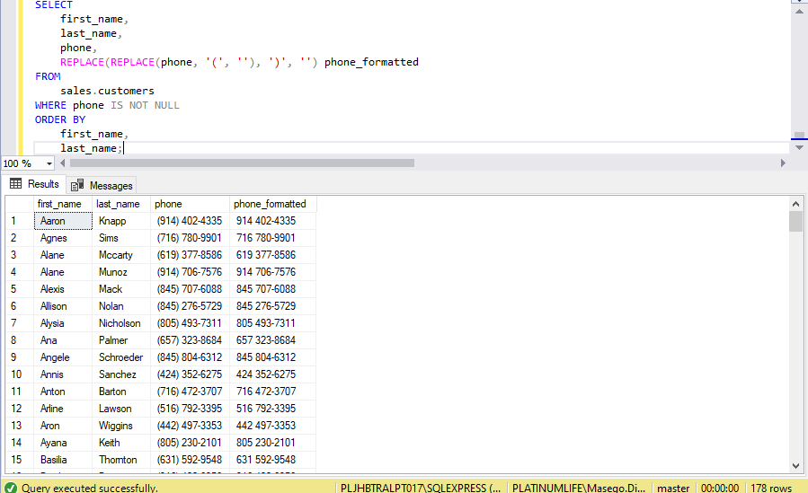
Replace() Example
Notes:
Example explained:
The inner REPLACE(phone ( ) replaces the character ( in the phone number by a space e.g. (916) 381-6003 -> 916) 381-6003
The outer reuses the result of the first call and replaces the character ) by a space e.g. 916) 381-6003 -> 916 381-6003.

Slide 28

String functions
Using the L&D Company database
Return the full name of the employees by combining the first name and last name
Return the full name of the employees by concatenating the first name and last names of all the accountants by using joins
Encode all the email addresses for all the employees using the appropriate function.
Decode all the email addresses for all the employees using the appropriate function.

Slide 29
Coalesce
The SQL Coalesce function lets you return an alternative value if an expression is NULL → in this case a 0
SELECT ProductName, UnitPrice * (UnitsInStock + COALESCE(UnitsOnOrder, 0)) FROM Products;
SELECT ProductName, UnitPrice * (UnitsInStock + IFNULL(UnitsOnOrder, 0)) FROM Products;
Notes:
The SQL Coalesce and IsNull functions are used to handle NULL values.
During the expression evaluation process the NULL values are replaced with the user-defined value.

Slide 30
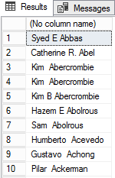
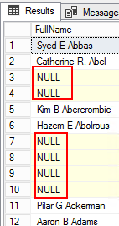
Coalesce
SELECT firstName + ‘ ‘ + MiddleName + ‘ ‘ + LastName FROM Person
If they don t have a middle name (if middle name column = null) then this will result in a null value for this calculation however:
SELECT firstName + ‘ ‘ +COALESCE(MiddleName) +’ ‘ + LastName FROM Person
This will now only add the middle name if there is one and a space if they dont have a middle name

Slide 31
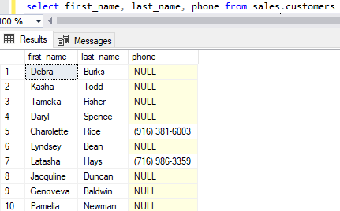
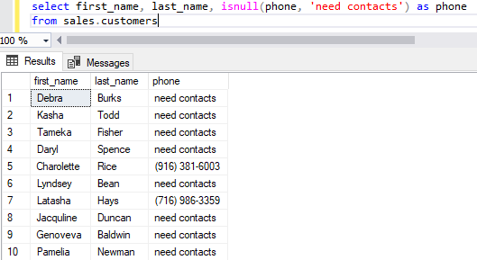
null functions
The NULL or ISNULL() function is used to replace the NULL values with a value or text.
Notes:
Example explained: If its null replace the null value with a 0

Slide 32
Null function continued..
Original:
SELECT ProductName, UnitPrice * (UnitsInStock + UnitsOnOrder) FROM Products;
Example of using the isnull:
SELECT ProductName, UnitPrice * (UnitsInStock + IF(IsNull(UnitsOnOrder), 0, UnitsOnOrder)) FROM Products;

Slide 33
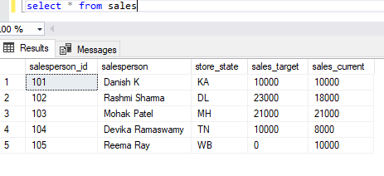
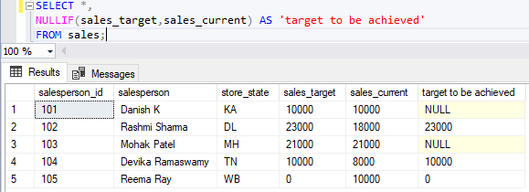
Nullif
When two expressions are compared the NULLIF() method is used.
If both expressions are equal the NULLIF() method returns NULL;
If both expressions are not equal it returns the first expression.

